Slide 1
TASK 3
Cross site scripting in Vulnweb.com

Slide 2
Cross site scripting in Vulnweb.com
Domain-vulnweb.com
Subdomain -http://testasp.vulnweb.com/
Steps to be followed
1) visit the site-http://testasp.vulnweb.com/
2)Find the search box and click on it
3)Intercept the request in burpsite and find different find different payloads for xss
4)Send request to intruder and paste all the payloads
5)Find the successful payload

Slide 3
Cross-site Scripting (XSS) is a client-side code injection attack. The attacker aims to execute malicious scripts in a web browser of the victim by including malicious code in a legitimate web page or web application.
A web page or web application is vulnerable to XSS if it uses unsanitized user input in the output that it generates.
Payload inserted is -
name=</script><script>prompt(28)</script>&submit=Searchphp?name=%3C/script%3E%3Cscript%3Eprompt(28)%3C/script%3E&submit=Search

Slide 4
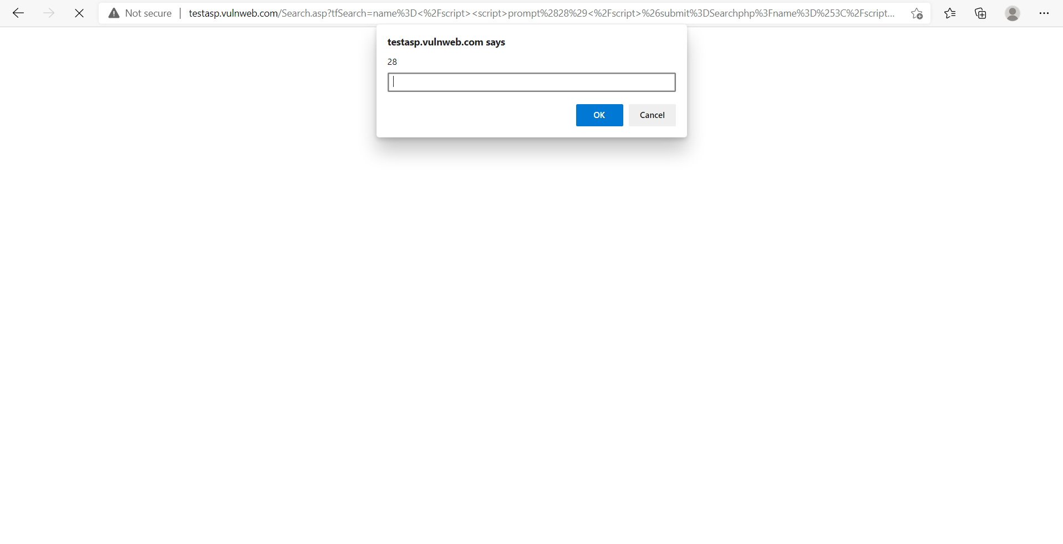

Slide 5
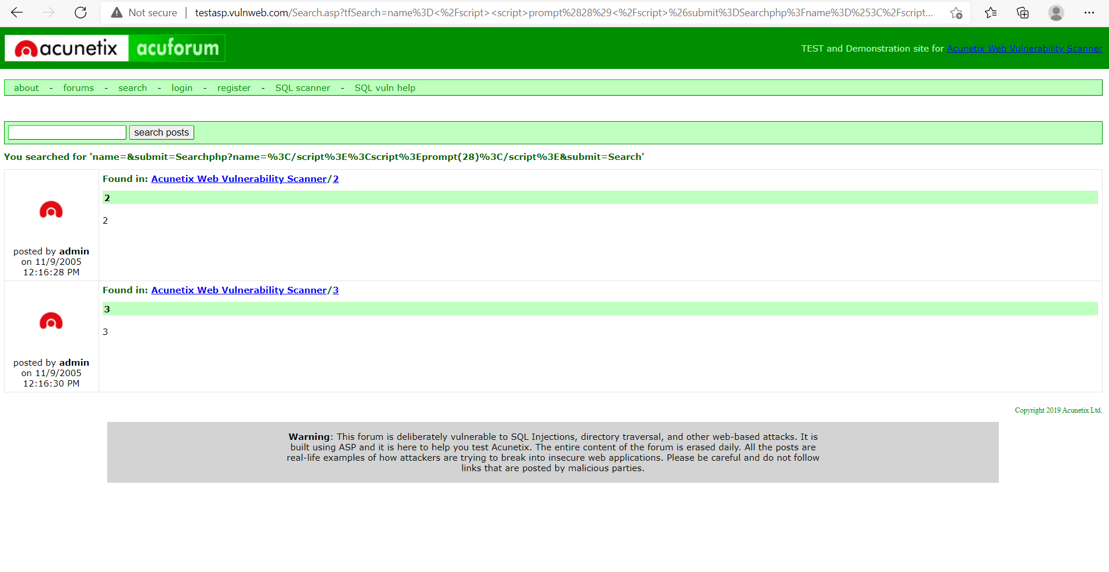

Slide 6
# Impact-
The underlying workings and business logic of a programme may be revealed depending on the source code, database connection strings, usernames, and passwords.
An attacker can launch the following attacks using this information:Use the database or other data resources to get information. It may be possible to read, update, or delete data depending on the account's privileges as determined by the source code.

Slide 7
#Actions to take
Confirm exactly what elements of the source code have been exposed; because to the restrictions of this sort of vulnerability, this may not be achievable in many cases. Confirm that this isn't a planned feature. Change the permissions on any files required by the application to prevent public users from viewing them. Remove it from the web server if it isn’t necessary

